Slide 1
STRESS DETECTION IN WOMEN USING SPEECH ANALYSIS BATCH C1 19251A05C3-A.Monika 19251A05E6-G.Sarvagna 19251A05F1-K.Meghana 19251A05F3-Shirley Angelina Internal Guide Mrs R Mamatha Assistant Professor Department of CSE

Slide 2
Agenda
1.INTRODUCTION
2.EXSISTING SYSTEM
3.PROPOSED SYSTEM
4.LITERATURE SURVEY
5.OBJECTIVES
6.DESIGN
7.IMPLEMENTATION
8.CONCLUSION

Slide 3
INTRODUCTION
Stress is one of the most common emotional state of humans.
Stress can be your friend or foe.
In general, Stress in women include pressures in their life, such as divorce, marriage, children, work and money pressures.
Oftentimes women are so busy that they don’t take time to slow down long enough to think about how stress is negatively affecting them.

Slide 4
EXSISTING SYSTEMS
Now-a-days, smart watches can be used for monitoring heart rate, blood pressure and skin temperature
Assessing stress using cortisol levels is still relatively invasive, requiring (for example) a blood or sample from the individual.
The above said limitations of physiological measurements make assessing stress using speech very attractive.

Slide 5
PROPOSED SYSTEMS
Voice Stress Analysis (VSA) is the study of analysing the mental states of women from their speech when they are under stress.
Steps in assessing stress using speech include:
1.Recording individual speech and capturing an audio signal.
2.Various features of audio signal(pitch, jitter, number of pauses etc,) are extracted.
3.Using those features as inputs which in turn yields a results.
4.That results depicts whether woman is under stress or not.

Slide 6
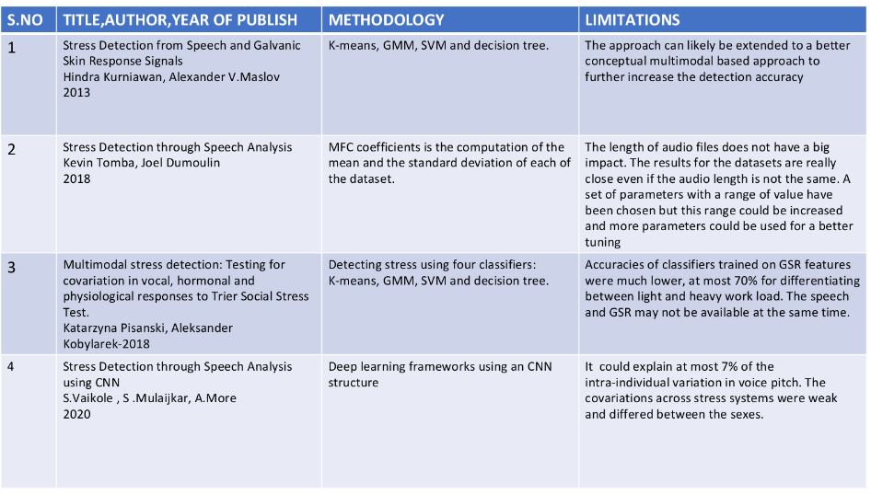
Literature Survey

Slide 7
OBJECTIVES
The main objective of proposed system is
→To build a voice stress analysing system using CNN algorithm.
→To depict the stress of a woman without their intervention.

Slide 8
A System Architecture wefn34ietfw4ekof
Audio clip(.wav file)
Conversion of audio clip to spectrogram
Data Pre-Processing
Feature Extraction
(MFCC)
Stress prediction
Actual Stress vs predicted stress are verified
C
CNN Model is Trained

Slide 9
Module-1: Conversion of audio clip to Spectrogram
After gathering the data, audio clip is pre-processed before giving it to the feature extraction module so as to improve the efficiency and accuracy of the feature extraction process
Converting audio clip to spectrogram can be achieved through librosa libraries.
Data pre-processing also includes data filtering to remove noises in a audio clip.

Slide 10
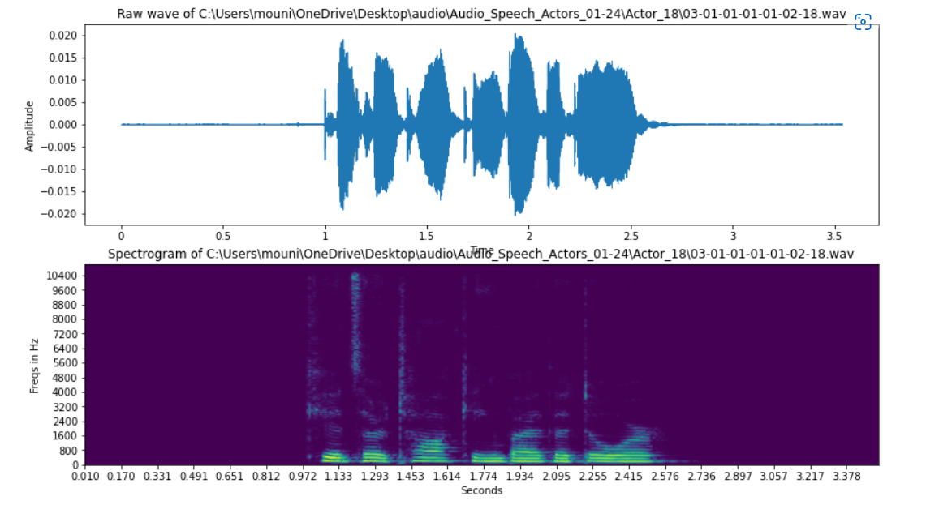
Audio clip to Spectrogram

Slide 11
Module-2: Feature Extraction
MFCC - Mel-Frequency Cepstral Coefficients(39 Coefficients).
The features like MFCC are obtained from the speech signal after
pre-processing stage.
The MFCCs of a signal are a small set of features which concisely describe the overall shape of a spectral envelope.
Feature extraction is achieved by importing librosa libraries.

Slide 12
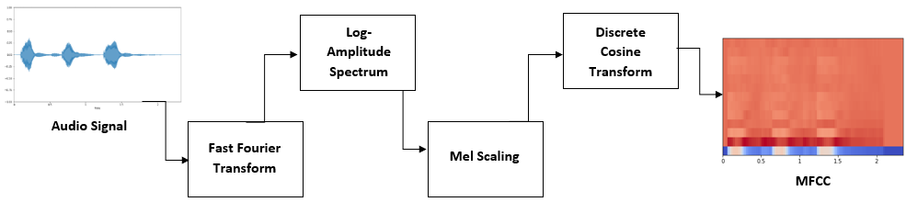
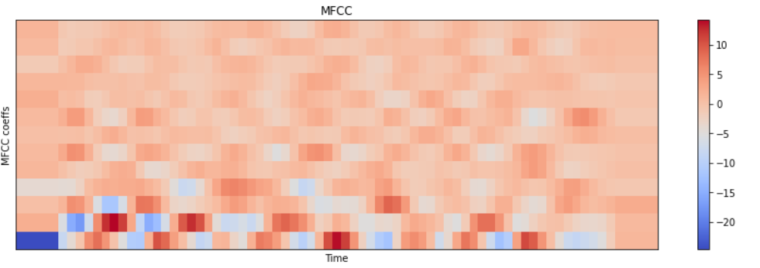
MFCC

Slide 13
Module-3: CNN model 1. A convolutional neural network (CNN) is a specific type of artificial neural network that uses perceptrons , a machine learning unit algorithm, for supervised learning, to analyze data. The CNN structure determines the user’s stress state by a hard decision process. At this time, we decided to make a label-based decision criterion to predict the stress status
2.The CNN structure and dense fully connected layer networks determines the status of stress output using a binary decision criterion (i.e., stressed or unstressed) .
3. The proposed module is composed of eight CNN layers and fully connected layers. The neural network layers capture the temporal information of the extracted features and calculate the frame-level output at every time sequence.

Slide 14
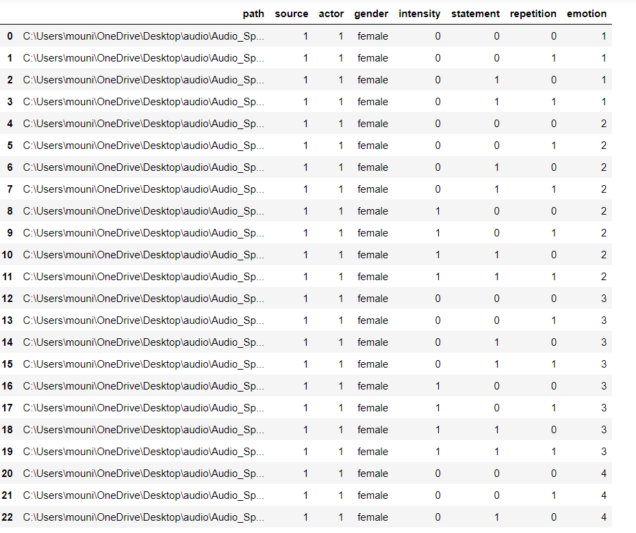
Dataset:
Speech file (Audio_Speech_Actors_01-24, 215 MB) contains 1440 files: 60 trials per actor x 24 actors = 1440.

Slide 15
Algorithm:
Step-1: Reading the dataset
Step-2:Plotting the audio file's waveform and its spectrogram
Step-3:Plotting MFCC
Step-4:Defining label to dataset
Step-5:Data Splitting
Step-6:Analyzing Features of audio files using librosa
Step-7:Data Making/Processing
Step-8:Creating the CNN Model
Set up Keras util functions
Model Summary
Compiling the model
Training the model
Evaluate loaded model on test data
Step-9:Predicting stress on the test data
Step-10:Actual Values vs Predicted Values

Slide 16
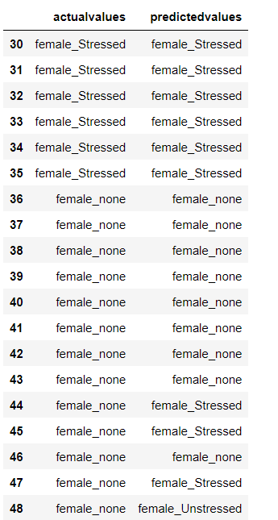
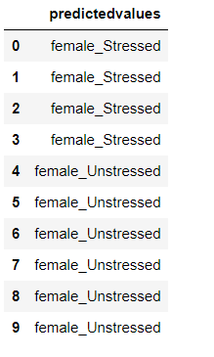

Result:

Slide 17
CONCLUSION
Stress can be positive and motivate women to achieve notable goals. But stress can also be negative and destructive.
Therefore, Detection of Stress in women is very important.
The potential of Machine learning algorithms is for developing robust, continuous, and noninvasive methods for stress detection ,with the end goal of improving the quality of life.

Slide 18
REFERENCES
Dr. S. Vaikole, S. Mulajkar, A. More, P. Jayaswal, S. Dhas. Stress Detection through Speech Analysis using Machine Learning,2020.
Kevin Tomba1 , Joel Dumoulin1 , Elena Mugellini1 , Omar Abou Khaled1. Stress Detection Through Speech Analysis,2018.
Hindra Kurniawan1, Alexandr V. Maslov1,2, Mykola Pechenizkiy1. Stress Detection from Speech and Galvanic Skin Response Signals.
Katarzyna Pisanskia,b,⁎ , Aleksander Kobylarekc , Luba Jakubowskad. Multimodal stress detection: Testing for covariation in vocal, hormonal , physiological responses to Trier Social Stress Test.2018
George M. Slavicha , Sara Taylorb and Rosalind W. Picardb. Stress measurement using speech: Recent advancements, validation issues, and privacy considerations.2019

